Slide 1
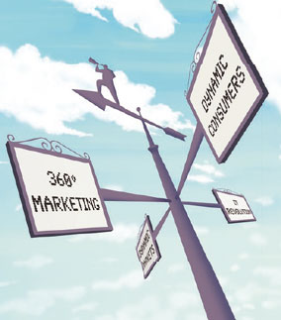
CHAPTER 3
CONSUMER BEHAVIOUR
-The indifference approach

Slide 2
Outcomes
The role play by consumer preference
Model of consumer preference – graphically
Role played by budget constraints
Role played by marginal utility

Slide 3
Consumer Behaviour
How will a typical consumer react and behave?
Why is the demand curve sloped downward from left to right?
Explain by using the indifference approach.

Slide 4
ASSUMPTION!
Consumers have needs.
Preference for goods and services.
Consumers cannot satisfy all needs.
Budget constaints.
Consumers try to maximise their satisfaction.
Given preferences and constraints.

Slide 5
CARDINAL AND ORDINAL SCALE
Cardinal scale = Utility approach:
Ex. Metric scale = cardinal scale
Measure distance and allow to compare different distances.
Physical measurements.
Ordinal scale = Indifference approach:
Indicates some distances longer, shorter, same.
No precise numbers.

Slide 6
CARDINAL UTILITY APPROACH
Based on assumption that satisfaction is measurable on a cardinal scale.
Different utilities can be precisely quantified.
Give the exact difference in marginal utility of products.

Slide 7
ORDINAL UTILITY APPROACH
Satisfaction obtained from consuming different products = Ordered or ranked!
Ranked in order of preference – Can’t give absolute level of satisfaction.
Size of utility difference cannot be established.
Rank:
High to low
Best to worst

Slide 8
INDIFFERENCE APPOACH
Based on Ordinal utility.
Less stringent more believable utility.
Compare different combinations
Not products in isolation.

Slide 9
Indifference approach: THREE BASIC ASSUMPTIONS
Completeness (Law of comparison):
Consumer is able to rank all possible combinations of goods and service in order of preference.
Consistency (Transitivity):
Consumers will act consistently.
More is better than less (Non-satiety):
Not fully satisfied and always prefer more to less. See implications on the following figure.

Slide 10
Let’s compare meat to beer

Slide 11
INDIFFERENCE CURVES
Indicate consumer’s tastes and preference by use of an indifference curve.
DEFINITION:
A curve which shows all the combinations of two products that will provide the consumer with equal levels of satisfaction or utility.
Combinations are equally desirable and the consumer is indifferent between them.

Slide 12
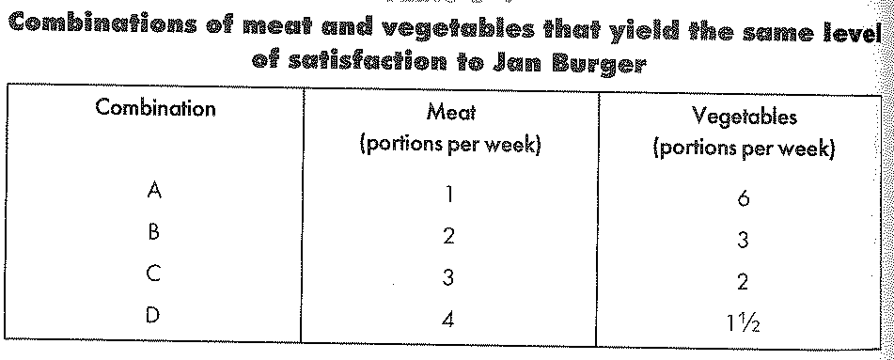
EXAMPLE
Jan consumes two products.
Doesn’t matter to him which combination he consumes = Indifferent

Slide 13
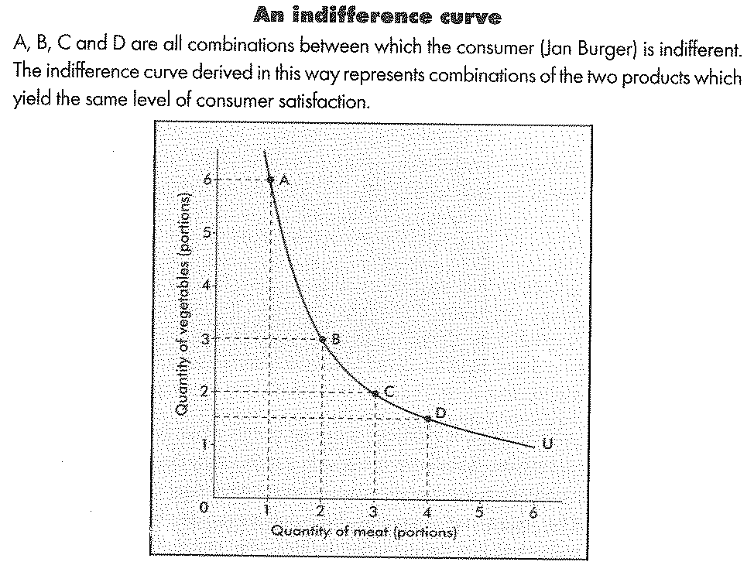
EXAMPLE

Slide 14
LAW OF SUBSTITUTION
Curve = Convex (viewed from origin).
Move down from the right – curve become flatter.
LAW OF SUBSTITUTION: The scarcer a good becomes, the greater the substitution value will be.

Slide 15
MARGINAL RATE OF SUBSTITION (MRS)
Will be the same regardless of the direction of exchange, and will correspond to the slope of an indifference curve (more precisely, to the slope multiplied by -1: to do away with the negative sign) passing through the consumption bundle in question, at that point
The rate at which Jan is prepared to substitute between pints is given by die slope of a straight line between the points = Exchange or substitution ratio.

Slide 16
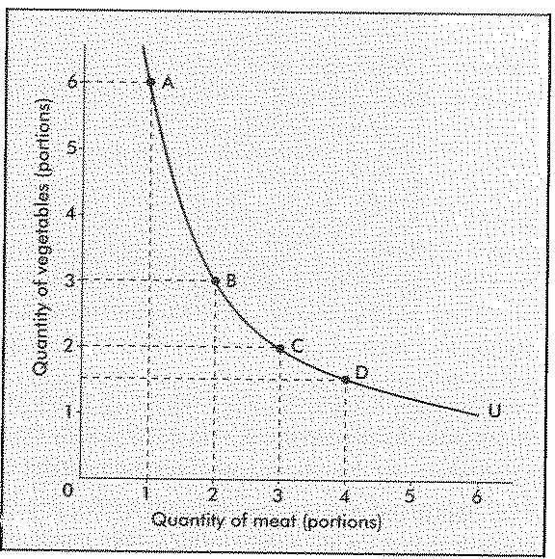
Exchange or substitution ratio
6-3=3
3-2=1

Slide 17
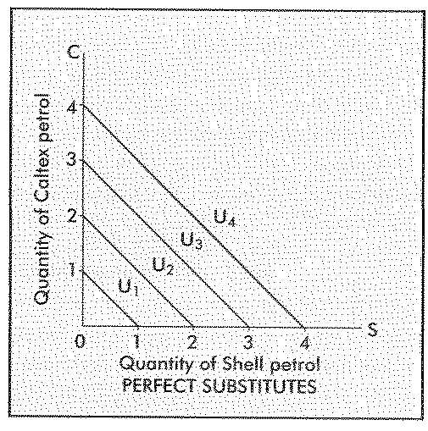
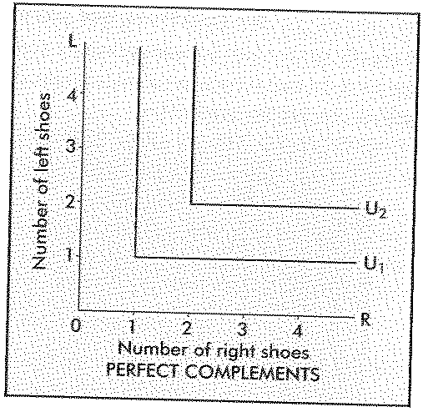
TWO EXTREME CASES

Slide 18
PROPERTIES OF THE INDIFFERENCE CURVES
Slope downwards = Left to right
Each level of satisfaction = Unique indifference curve
Indifference map = Infinite number of indifference curves
Further you move away from the origin, the higher the level of satisfaction.

Slide 19
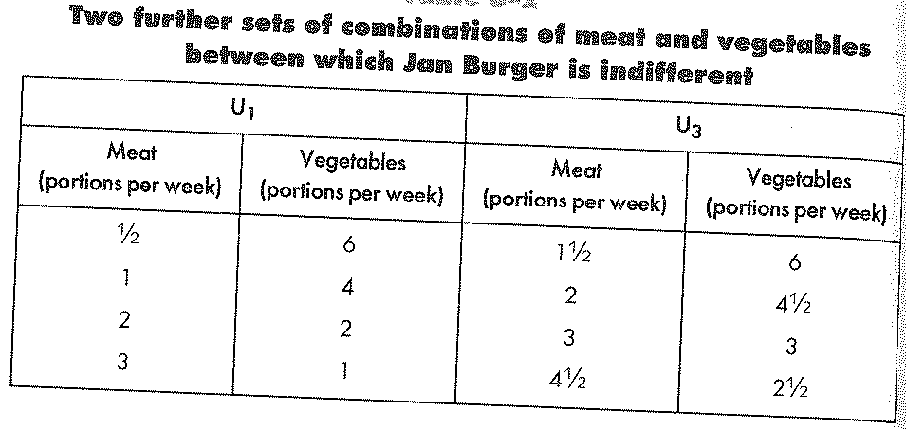
U1 = lowest satisfaction
U3 = highest satisfaction
U2 = origin

Slide 20
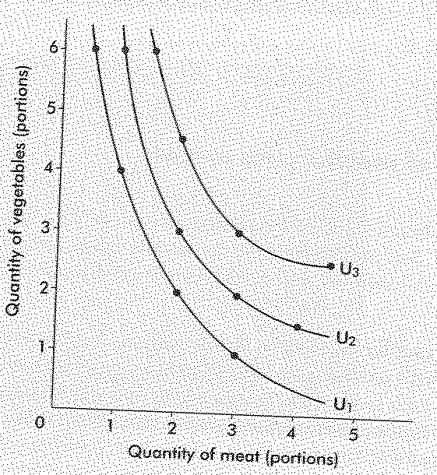
INDIFFERENCE MAP

Slide 21
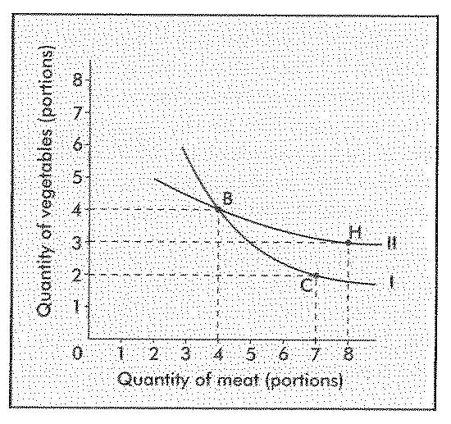
INDIFFERENCE CURVES CANNOT INTERSECT!

Slide 22
BUDGET LINE
Indicates all combinations of the 2 products the consumer can afford to purchase with the amount of income at his disposal.
Budget line = Consumption possibility curve = Expenditure line = Budget constraint
Intercepts both axis's = Min and Max
Slope of budget line = Qv/Qm = Exchange ratio = Opportunity cost of ex. Meat: Vegetables

Slide 23
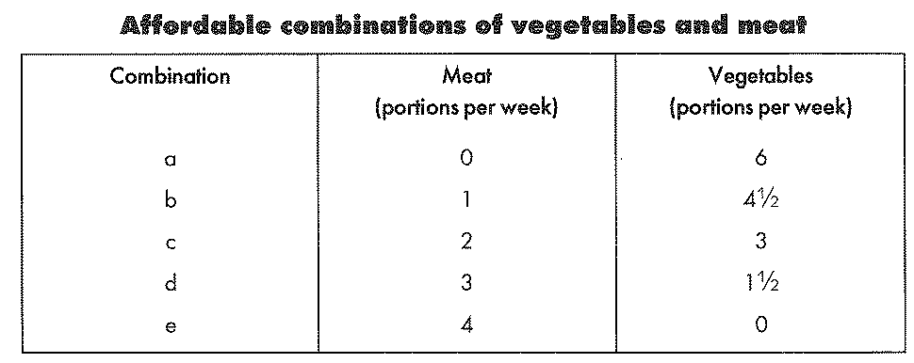
BUDGET LINE
Combinations that a consumer can afford

Slide 24
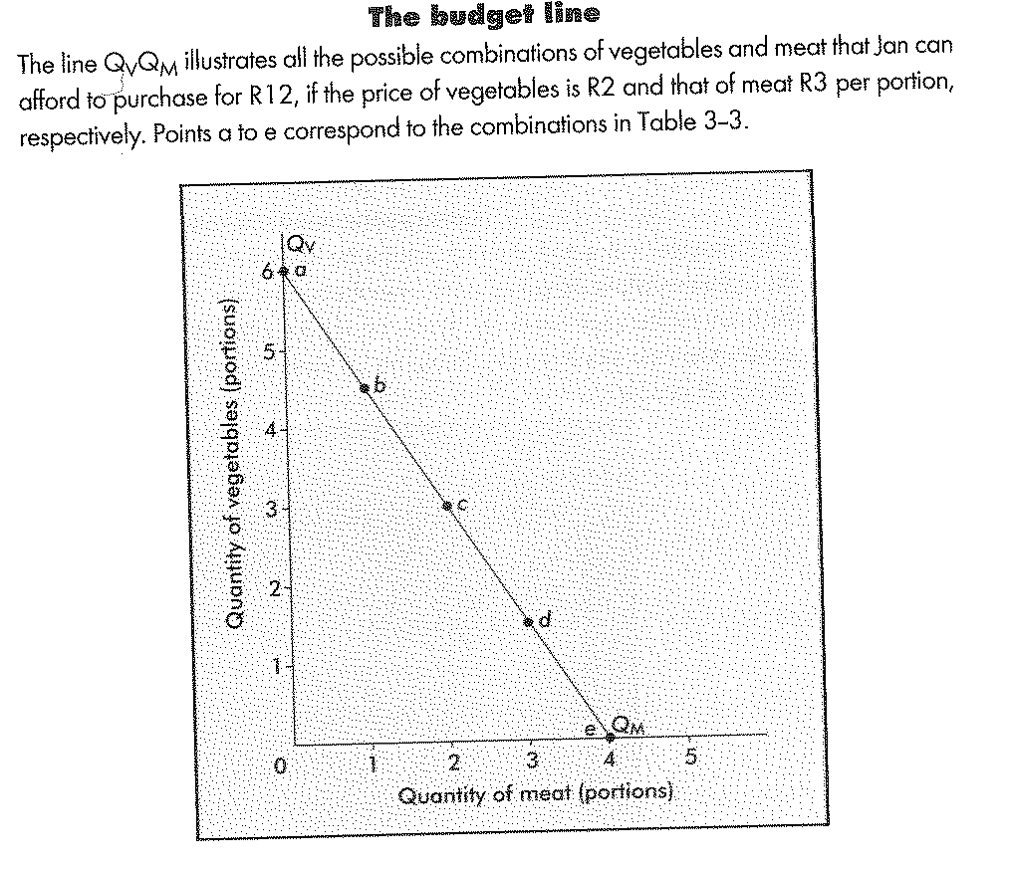
BUDGET LINE

Slide 25
CONSUMER EQUILIBRIUM
Axes of budget line SAME Axes of indifference map
∴Superimpose!
Indifference map = Infinite number of indifference curves.
For our purpose only show 3 curves to explain equilibrium.

Slide 26
CONSUMER EQUILIBRIUM -Graphical Approach
Jan Burger can choose any point on Budget line QvQm.
Above to right = Unaffordable
Below to left = Ignore (Assume Jan will spend all money available)
Equilibrium = Maximum satisfaction for the amount he spends

Slide 27
CONSUMER EQUILIBRIUM -Graphical Approach
Equilibrium = Point V
Two lines touch, NO intersection!
Highest level of satisfaction!
At point V:
Slope of IC =Slope of BL
Notes:
If the indifference curve intersect or do no not touch = Lower level of satisfaction or beyond consumers means.

Slide 28
CONSUMER EQUILIBRIUM -Algebraic Approach
Derive consumer equilibrium by using symbols and equations.
I = Available income
Qx = Good X and Px = Price of good x
Qy = Good Y and Py = Price of good y
Budget line: I = Amount spent on goods x and y.
∴Income = PyQy PLUS PxQx

Slide 29
Algebraic Approach for the budget line
REMEMBER WE ARE IN EQUILIBRIUM
I = (P_{y}Q_{y}) + (P_{x}Q_{x}) - Divide by Py
I/P_{y} = Q_{y} + (P_{x}Q_{x})/P_{y} - Subtract (PxQx)/Py
I/P_{y} - (P_{x}Q_{x})/P_{y} = Q_{y} - Switch sides, rewrite
Q_{y} = I/P_{y} (P_{x}/P_{y})Q_{x}
This is the equation of the straight line
I/Py = Intercept of vertical axis
P_{x}/P_{y} = Slope of the budget line

Slide 30
Algebraic Approach for the indifference curve
We can use the same approach for the indifference curve.
Points on IC = Same level of satisfaction or total utility.
Total utility unchanged as consumer moves from one point to another on IC.
∴Condition to be met:
Δ Q_{y} x MU_{y} = Δ Q_{x} x MU_{x}

Slide 31
Algebraic Approach for the indifference curve
ΔQ_{y} x MU_{y} = Δ Q_{x} x MU_{x}
Rearrange the equation:
ΔQ_{y}/Δ Q_{x} = MU_{y} /Mu_{x}
ΔQ_{y}/Δ Q_{x} = Slope of IC
MU_{y} /Mu_{x} = MU of two goods x and y
ΔQ_{y}/Δ Q_{x} = MU_{y} /Mu_{x} = MRS

Slide 32
MANIPULATION OF THE FORMULAE
Reconsider equilibrium
MRS = Slope of BL = Slope of IC
MRS = ΔQ_{y}/Δ Q_{x} = MU_{y} /Mu_{x} = P_{x}/P_{y}
At Equilibrium: MU and price of the goods must be in proportion to one another.
LAW OF EQUALISING THE WEIGHTED MARGINAL UTILITIES

Slide 33
LAW OF EQUALISING WEIGHTED MARGINAL UTILITIES
MU_{y} /P_{y} = MU_{x} /P_{x}
Meaning: The consumer is only in equilibrium when he derives the same marginal utility from the last rand spent on good x as from the last rand spent on good y.
Expand the equation:
MU_{y} /P_{y} = MU_{x} /P_{x = … =} MU_{n} /P_{n}

