Slide 1
Learning Unit 6
Production and Operations

Slide 2
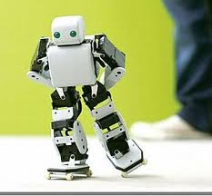
QUICK RECAP! Learning unit 5
Contemporary issues?
Globalisation
New technology
Information technology
New world of work
Increased demand of consumers
Contemporary issues in SA?

Slide 3
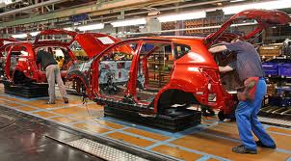
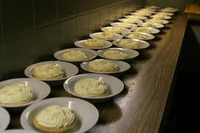
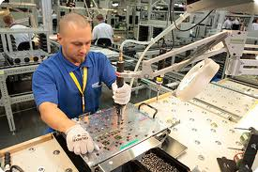
Outcomes
Production vs. Operations
Importance of quality management
Role of procurement or purchasing in an organisation
Conventional procurement vs.
e-procurement

Slide 4
Why do businesses exist?
MAKE MONEY!
SURVIVE!
What to produce?
For whom to produce?

Slide 5
High level output
Low input

Slide 6
Production and Operations Management
POM =
Activities of planning production processes
Designing production system
Managing the way in which production systems operate

Slide 7
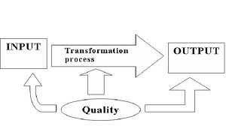
Production vs. Operation
Production = Transformation of tangible inputs and intangible inputs.
Tangible: Raw materials, semi-finished goods or subassemblies
Intangible: Ideas, information, know how

Slide 8
Production vs. Operation
Operations:
Making a product; or
Providing a service.

Slide 9
Production and Operations Management
POM = Strategic vision and goals of the business.
Process overseen by operations management.
Ensure effectiveness and efficiency

Slide 10
Production and Operations Management
4 Elements of business operations:
Business strategy
Production process
Process management
Production

Slide 11
Business Strategy
Direction or scope over long term
By configuration of resources
Challenging environment
Meet needs of markets
Fulfil stakeholder expectations
Ops manager carefully plan POM.
Best product
Best methods
Saving costs

Slide 12
Production Processes
Production:
The use of resources
To create goods or services
Suitable for exchange
Processes:
Manufacturing
Storing
Shipping
Packaging

Slide 13
Process Management
Align the business with wants and needs of customers
Oversee the production process
Ensure tasks completed on time
Everything in place
Running smoothly
Implement solutions to problems

Slide 14
Production
Changing inputs into outputs
Ideas ← Imagination + Creativity
Solutions and Service ← Special skills
Physical products ← Raw material
Output → Productivity
Productivity = Output and the inputs used to produce it

Slide 15
Total Quality Management
TQM:
Improvement of products and services inside the business; and
satisfying the customer outside the business
TQM =
Understand customer wants
Find problem areas and improve
Train employees to use new technology

Slide 16
TQM considerations
Ways to measure product and service quality
Reward achievement of goals
Encourage total quality throughout the organisation
Management lead by example
Ways to determine improved quality

Slide 17
Procurement = Purchasing
The acquisition of G&S at:
Best cost of ownership
Right quantity
Right quality
Right time
Right place
From the right source
For direct benefit
1x B
4x R’s
2x F’s

Slide 18
Typical procurement cycle

Slide 19
What price to pay?
Pricelists
Catalogues
Discount schedules
Tenders
Quotations

Slide 21
Catalogue

Slide 22
Discount schedules

Slide 23
Tenders

Slide 25
e-Procurement
Use of electronic systems
To purchase goods, works and services
Process payments from 3rd parties
Electronic buying
Through use of computers; and
Internet technology

Slide 26
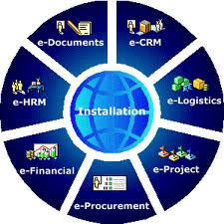
e-Procurement
Conventional method = Manual
Modern method = Electronically
➔ e-Commerce

Slide 27
Advantages of e-Procurement
Cost saving
Efficiency
Speed
Accuracy

Slide 28
Disadvantages of e-Procurement
High-cost
Time consuming

Slide 29
Models of e-Procurement
Private models
Public models
Third-party models

