Slide 1
Unit 10
MARKET POWER:
Monopoly and Monopsony

Slide 2
Outcomes
Define monopoly market power
Identify sources of monopoly power
Determine the social cost of monopoly power
Define monopsony market power

Slide 3
Introduction
Monopoly: Market with only one seller.
Monopsony: Market with only one buyer
Market power: Ability of a buyer or seller to affect the price of a good.
Monopoly
Perfect
Competition
Monopsony

Slide 4
Monopoly
Unique position – Increase in price, no need to worry about:
Competitors; and
Losing market share.
Can’t make price to high – who will buy?
For max profit:
Determine cost
Characteristics of market demand
Then, how much to produce and sell

Slide 5
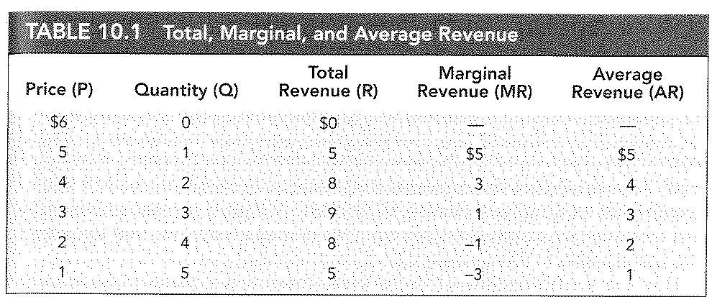
Monopoly: AR and MR
AR = market demand curve
MR⁺ = increasing revenue
MR⁻ = decreasing revenue

Slide 6
Monopoly: AR and MR

Slide 7
Monopoly: Output Decision
Maximum profit where MR = MC.
Market demand curve = AR
Price per unit monopolist receive as a functions of total output.
Graph page 352 and 354

Slide 8
Monopoly: Output Decision

Slide 9
Monopoly: Output Decision

Slide 10
Monopoly: Shifts in demand
Relationship between price and Qsupplied = Supply curve.
Monopolistic market = NO supply curve!
Output decision based on MC and demand curve
Shifts in demand curve lead to change in price and/or output
Graph page 358

Slide 11
Monopoly: Shifts in demand

Slide 12
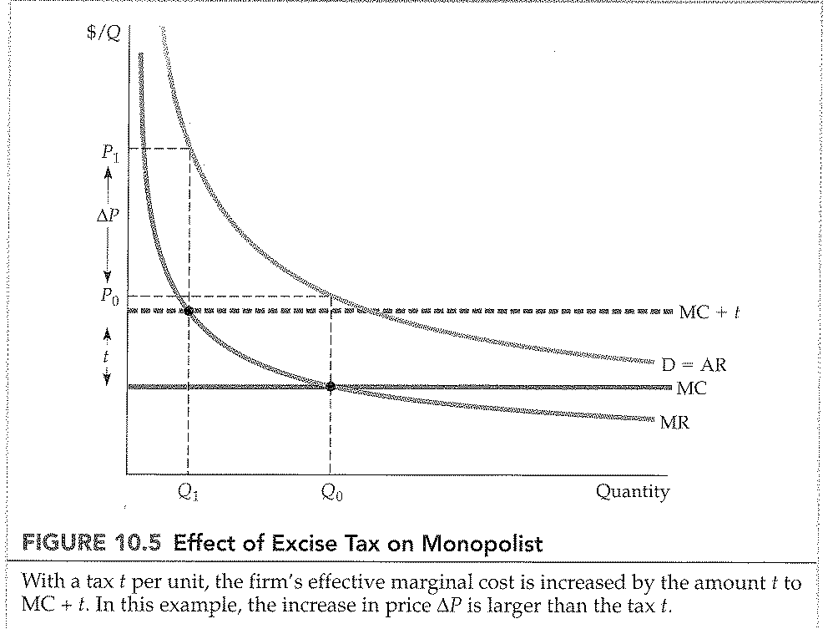
Monopoly: Effect of a tax
Price rise by more than the tax.
MC is increased by the amount of the tax.
MR = MC + t

Slide 13
Monopoly: The Multiplant firm
Production in two or more different plants with different operating costs.
How to choose output?
Step 1: Total output divided between two plants → so that → MC is same in both plants.
Step 2: Make sure MC = MR
Produce in plant more where cost is lowest and less in other plant, or relocate
Thus, MR = MC₁ + MC₂

Slide 14
Monopoly: The Multiplant firm

Slide 15
Monopoly Power
Pure monopoly is rare
Questions:
Does a market with more than one firm have monopoly power or not?
What are the sources of monopoly power?

Slide 16
Monopoly Power
Test monopoly power by using:
The Lerner Index of Monopoly Power
L = (P-MC)/P
Index always between 0 and 1
Perfect competition: P = MC thus L = 0
Larger L = Greater degree of monopoly power
Also expressed as an elasticity: L = -1/E_{d}

Slide 17
Sources of Monopoly Power
Monopoly power: Ability to set price above MC
P>MC: Depend on firm’s elasticity of demand
Thus, the less elastic the demand curve, the more monopoly power a firm has.
Three factors to determine a firm’s elastic demand:
The elasticity of market demand
The number of firms in the market
Interaction among firms

Slide 18
Sources of Monopoly Power
Elasticity of demand
Firm’s own demand as elastic as market demand
Elasticity of market will limit monopoly power
Number of firms
Many firms, unlikely for one firm to affect price
Interaction amongst firms
If rivalry aggressive, unable to profitably raise price

Slide 19
Social cost of monopoly power
Monopoly power: P>MC
Priced high, produce lower quantities = Expect customers worse off and firms better off
Assume welfare of consumers and producers are the same = Monopoly power make better or worse?

Slide 20
Social cost of monopoly power

Slide 21
Social cost of monopoly power
Rent seeking:
Deadweight loss is B+C = social cost of monopoly power.
Firm may engage rent- seeking: Spend money in socially unproductive efforts to acquire, maintain or exercise monopoly.
Example: Contributing to a political campaign, get involved in advertising or other legal efforts.

Slide 22
Social cost of monopoly power
Price regulation:
Antitrust laws prevent firms from gaining excessive amounts of monopoly power.
Limitation by government
Graph 371

Slide 23
Social cost of monopoly power

Slide 24
Social cost of monopoly power
Natural monopoly:
Firm can produce the entire output of the market at a cost lower that what it will be with several firms.
Arises if there is strong economies of scale

Slide 25
Social cost of monopoly power

Slide 26
Social cost of monopoly power
Regulation in Practice:
Minimum feasible price for natural monopoly where AR = Demand
Unfortunately difficult to determine accurate price
Demand and cost curves shifts as market conditions evolve
Thus, regulation based on rate of return earned on capital.
Rate-of-return regulation: Maximum price allowed by a regulatory agency is based on the rate of return a firm will earn.

Slide 27
Monopsony
Not to many buyers – have a market power and affect a profitable price to pay.
Monopsony: Market with a single buyer.
Oligopsony: Market with a few buyers.
Keep on purchasing until last unit adds value, additional benefit offset by additional cost.
Additional benefit from purchasing = Marginal value
Additional cost of buying = Marginal expenditure

Slide 28
Monopsony
Marginal value = Demand curve → Downward sloping
Competitive buyer: No influence over price = Market price = Average expenditure = Marginal expenditure
Monopsony power buyer: Purchase smaller quantity at lower price = AE = Supply curve

Slide 29
Monopsony

Slide 30
Monopsony

Slide 31
Monopsony

Slide 32
Monopsony Power
Sources:
Elasticity of market supply
Upward-sloping supply curve = benefit!
ME > AE = less elastic supply curve
High elasticity = low monopsony power
Number of buyers
More buyers = no power
Less buyers = more power
Interaction among buyers
Aggressive buyer competition = no power

Slide 33
Social costs of monopsony power
Does monopsony power increase welfare?
Compare buyer surplus and seller surplus
Deadweight loss from monopsony power = inefficiency = social cost
Inefficiency = Output lower than under competition

Slide 34
Bilateral monopoly
Market with one seller and one buyer
Monopsony and monopoly
Powers will counteract each other, residual power will be significant.
Monopsony power push price closer to MC
Monopoly power push price closer to MV

