Slide 1
Study Unit 7
The cost of production

Slide 2
Outcomes
Different concepts of costs in economics
Cost in the short run
Cost in the long run
Short run cost vs. long run cost
Economies of scope

Slide 3
Measuring cost: Which costs matter?
Economic vs. Accounting cost
Fixed cost vs. Variable cost
Opportunity cost and Sunk cost
Marginal vs. Average cost

Slide 4
Measuring cost: Which costs matter?
Accounting cost | Economic cost
Actual expenses + Depreciation charges on capital equipment | Cost to firm for utilizing resources in production + Opportunity costs

Slide 5
Measuring cost: Which costs matter?
Opportunity cost | Sunk cost
Cost associated with opportunities that are ‘given up’ when a firm’s resources are not put to their best alternative use | Expenditure that has been made and cannot be recovered
EXAMPLE: Firm purchase specialized machinery which has one specific use. Because it cannot produce an alternative, opportunity cost = 0. But expenditure on the machinery = sunk cost.

Slide 6
Measuring cost: Which costs matter?
Fixed cost (FC) | Variable cost (VC)
Cost doesn’t vary with level of output. Can only eliminate by shutting down. | Cost that varies as output varies.
TOTAL COST (TC)

Slide 7
Measuring cost: Which costs matter?
Marginal cost (MC) | Average cost = Average total cost (ATC)
Increase in cost resulting form the production of one extra unit of output. | Firm’s total cost divided by level of output
Average fixed cost (AFC) = Fixed cost divided by the level of output
Average variable cost (AVC) = Variable cost divided by the level of output

Slide 9
A firm’s costs

Slide 10
Cost in the short run
Two methods to explain costs:
Short run production functions
Isoquant production functions

Slide 11
Short-run total production functions
From production to cost:
Assume firm hire labour @ fixed wage (w)
Thus, MC = ∆VC/ ∆q
MC = ∆VC/ ∆q = w ∆L/ ∆q
MC = w/MP_{L}
AVC = w/AP_{L}
Decrease in MP = Law of diminishing marginal returns.

Slide 12
Relationship between production and cost

Slide 13
SG page 77 Characteristics of short-run cost curves

Slide 14
Production function: Isoquants
Both inputs variable → Long run
More flexible
Firm can expand or contract more labour
Change design of products or introduce new ones
One fixed one variable → Short run

Slide 15
Production function: Isoquants Cost in the long run
Assumption: Capital rented
User cost of capital: Annual cost of owning and using capital asset = Economic depreciation + Forgone interest
User cost of capital =
Depreciation + (Interest rate * Capital value
r = Depreciation rate + i

Slide 16
Production function: Isoquants Cost-minimizing Input Choice
Fundamental problem for firms:
How to select inputs
to produce given output
at minimum cost
For simplicity – 2 outputs:
Labour = measured hours of work per year
Capital =measured hours of use of machinery py

Slide 17
Production function: Isoquants Cost-minimizing Input Choice
Amount used depend on price
Labour = Price simply wage, w
Price of capital:
LR firm can adjust amount used
Firm decide prospectively how much to use
Large initial expenditure
Expressed as a flow i.e. R/$ per year
Must amortize: Spread over lifetime of the capital
Account forgone interest if invested

Slide 18
Production function: Isoquants Cost-minimizing Input Choice
Rental rate of capital:
Rent capital than purchase
Thus, Rental rate
No distinction between rented and owned

Slide 19
Production function: Isoquants Isocost line
Definition:
Graph showing all possible combinations
Of labour and capital
That can be purchased
For a given total cost
Total cost = labour cost and capital cost
C = wL + K

Slide 20
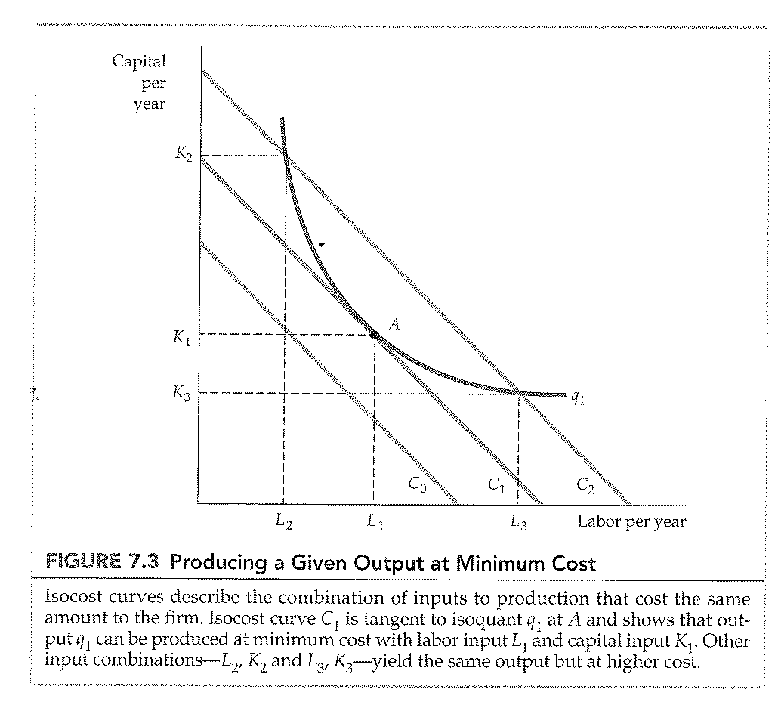
Production function: Isoquants Isocost line
Re-write as and equation for a straight line:
K = C/r – (w/r)L
Slope = (∆K/∆L) or – (w/r)

Slide 21
Production function: Isoquants Choosing inputs
Producer limited by production budget and input prices

Slide 22
The LR and SR expansion path
2 variable inputs = LR
Assume various output levels
Different cost minimising points
Expansion path = curve passing through tangent points – LR expansion path
Capital constant in SR = Line KK = SR expansion path

Slide 23
The LR and SR expansion path

Slide 24
LR vs. SR cost curves
Inflexibility of SR production:
LR flexible: The planning horizon long enough to allow change.
Allows firm to produce lower LAC
SR: Capital is fixed and firm unable to substitute expensive and inexpensive capital.
Reflected in SR expansion path

Slide 25
Inflexibility of SR Production

Slide 26
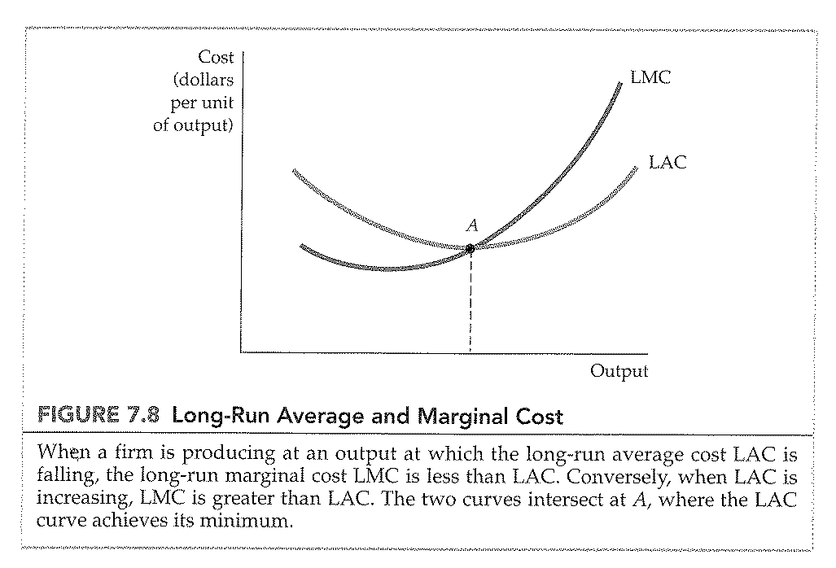
LR vs. SR cost curves
LR average cost (LAC):
LR ability to change input = save cost
Monitor how cost vary as firm move on expansion path = use LAC and LMC

Slide 27
LR and SR cost curves Economies and diseconomies of scale
As input ↑ AC of producing will ↓ to a point
Why:
Operate on large scale, workers specialize = more productive
Provide flexibility = varying combinations of input
Firm can acquire inputs at lower cost when bought in bigger quantities

Slide 28
LR and SR cost curves Economies and diseconomies of scale
But, AC will ↑ at some point as output↑:
In SR, space and machinery make it difficult to produce effectively.
Managing a larger firm is more complex and inefficient as task increases.
Advantage to buy in bulk can disappear if certain quantity reached.

Slide 29
LR and SR cost curves Economies and diseconomies of scale
Analyse relationship between operation and cost
Recognise input ration changes
Expansion path no longer straight line
Returns to scale no longer exist.
Rather firm enjoys economies of scale:
Output can be doubled for less that doubling cost
Or diseconomies of scale:
Doubling output = more than double cost

Slide 30
Short run vs. Long run cost

Slide 31
Production with two outputs
Economies of scale: Cost per unit declines as production increase.
Economies of scope: The joint output for different products is higher than products produced in separate firms
Product transformation curve: Various combinations of two different output produced with a set of inputs

Slide 32
Product Transformation curve

Slide 33
Degree of economies of scope
Percentage of cost savings resulting from producing two products jointly
SC = C(q1) + C(q2) – C(q1,q2)
C(q1,q2)

